Slide 1
Regression
(4 of 4)
Jeanette Mumford
Notes:
16 minutes

Slide 2
Place to ask questions
(anonymous, but be polite)
tinyurl.com/questions-for-jeanette

Slide 3
Goals
Work with the Glm GUI
  Directly used to make design matrices and contrasts for randomise
  Similar to the Feat GLM setup (aka when you’re not using randomise)
Fire up a terminal and get ready to follow along!

Slide 4
Models we will set up
1-sample t-test
2-sample t-test
Paired t-test (we haven’t seen this one yet!)
  Let’s review the paired t-test first

Slide 5
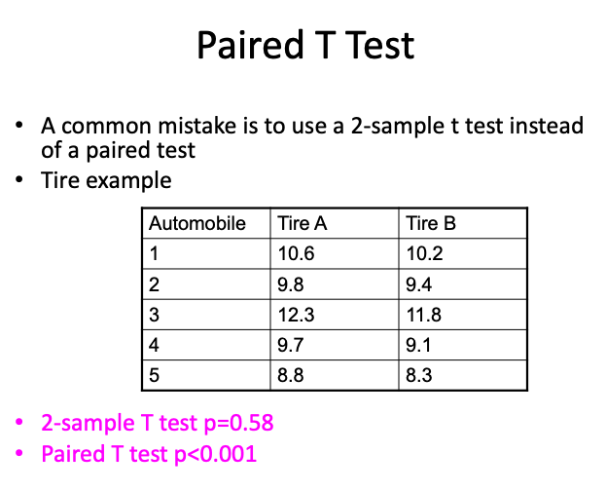

Slide 6
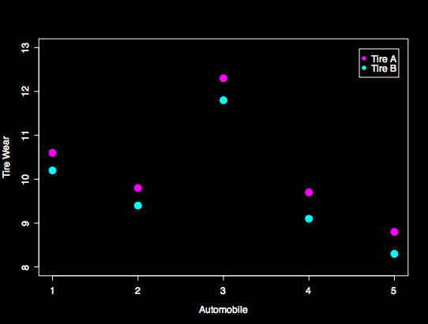
Why so different?

Slide 7
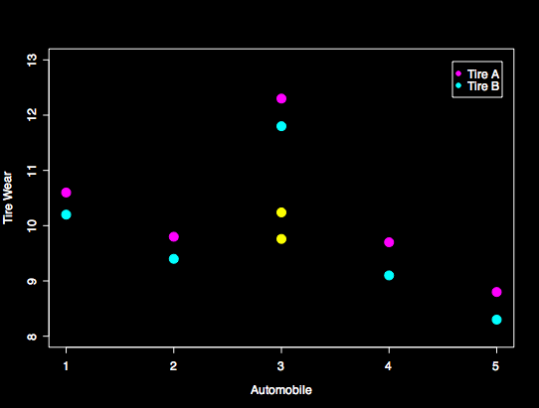
Why so different?
Mean difference is perfect, but residuals are HUGE
Correlation between pairs of data points is ignored

Slide 8
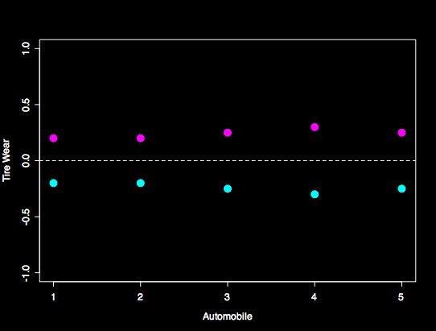
How to fix it: Center values within-subject first

Slide 9
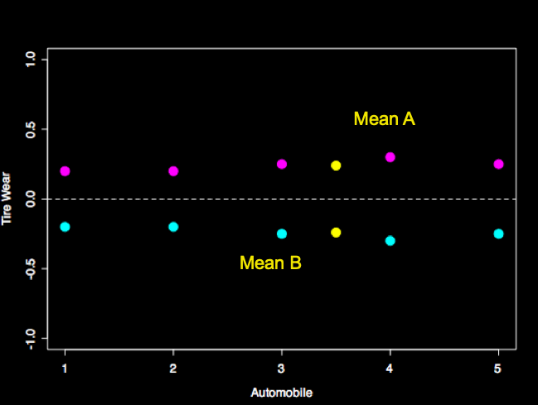
How to fix it: Center values within-subject first
Mean difference is exactly the same, but residuals are much smaller
Repeated measures have been accounted for

Slide 10
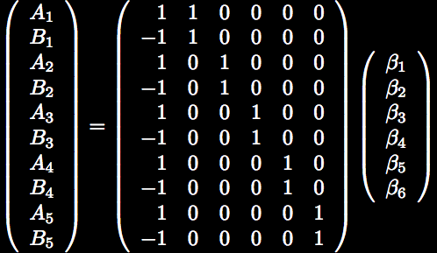
The model

Slide 11
Important note
Setting this model up in the GUI is not fun AND is often completely avoidable
Estimate the paired differences ahead of time!
  Then your model is a 1-sample t-test
  With fMRI analyses via Feat, you can easily do this in a first or second level model
  With randomise-based models, fslmaths can be used to calculate image differences

Slide 12
That’s it!

